Slide 1
Getting Database Code into a VCS

Slide 2
2.1 – VCS Challenges

Slide 3
The Challenges of Database Code
SQL Server:
Code is not in a file by default
Every object may or may not exist in separate files
Lack of tooling for working with a VCS
SQL Code
Latest version of the code might not be sufficient
Automatic merges typically don’t work
Notes:
#The Challenges of Getting Database Code into a VCS
All professional developers recognize the value of using version control. Even in small teams, it seems that most application software developers have learned that using a VCS is prudent and easy. Version control systems have improved their ability to manage a variety of code types as well as team paradigms. The last ten years have seen quite a few open source and free systems, to the point where there is no excuse these days for any software developer not to use version control. Git, in particular, has gained a tremendous following in the last few years, with even TFS providing a git interface for developers.
However, we have a number of challenges in database development that lead people away from working with Version Control. Let's look at SQL Server in particular and also the varagies of SQL code itself that present difficulties.
One of the challenges many developers have with storing their database code in version control is that they often develop code in a tool such as Management Studio, the code is compiled on the SQL Server instance, and there never is a file that the developer has to save to a VCS.
This is fundamentally different from most other types of development, where a developer works with various text files containing code, saves them, and then compiles or copies them to a server. In relational database development, the code is often never saved as a file, and indeed, the process can be cumbersome getting the code into files.
We also have the issue of each object not easily separated into a separate file. For example, we have tables in databases, which can have indexes, constraints, extended properties, permissions, and more. We can alter a table to include new structures, but the code we would use is completely different, and doesn't even include the old code. Contrast this with the addition of a method to a C# file.
There is a lack of database development tooling, especially for SQL Server databases. Management Studio doesn't easily integrate with version control, and neither do most other editors. Some third party partners have produced tools, and SSDT builds on the Visual Studio capabilities with an offline schema model, but all of these methods require the developer to take actions outside of just writing code, compiling it, clicking save, and then clicking commit. There hasn't been a habit among developers of actually committing code, perhaps because we may write code and compile it, but often developers may tweak the code actually stored in the database and tracking those changes to commit them to version control isn't as easy as it sounds.
Since the database isn’t tightly linked to the code the developer works on, and we often find developers making changes to databases to test code, and then forgetting to save this in a VCS, years of bad habits have resulted in relatively few people understanding how to save their database code.
In addition, the vagaries of the SQL language cause us issues. As I mentioned, I could add permissions or indexes to a table, and don't include the existing code for the table. However, for most of the life of SQL, the language itself differs from other application languages. For example, to make a new object, I use the CREATE statement. To change this, I often use the ALTER statement instead, fundamentally altering language based on timing, not logic. SQL Server 2016 SP1 and Azure help by introducing the CREATE OR ALTER statement, but for most developers using SQL Server (or other relational databases), their code must either take this into account or multiple versions of the code, of which all might not be valid, are needed to recreate the object. This is fundamentally not what we would like to see in a VCS respository.
This strange structure of the T-SQL language means that many techniques we use in team development to reconcile version differences are difficult or impossible to easily use. For example, merges of code are complex, requiring humans to decode and decide which changes to choose from each file. The lack of automatic merging means that team development does not easily scale. A number of developers look to try and link their development database with a VCS and implementing locking to prevent more than one developer from changing an object. Past experience shows this is a places where VCS use becomes cumbersome and thus often ignored.
In the next section, we will look at a few ways that we can store our code, and data, in a VCS.

Slide 4
2.2 – Get Code in VCS

Slide 5
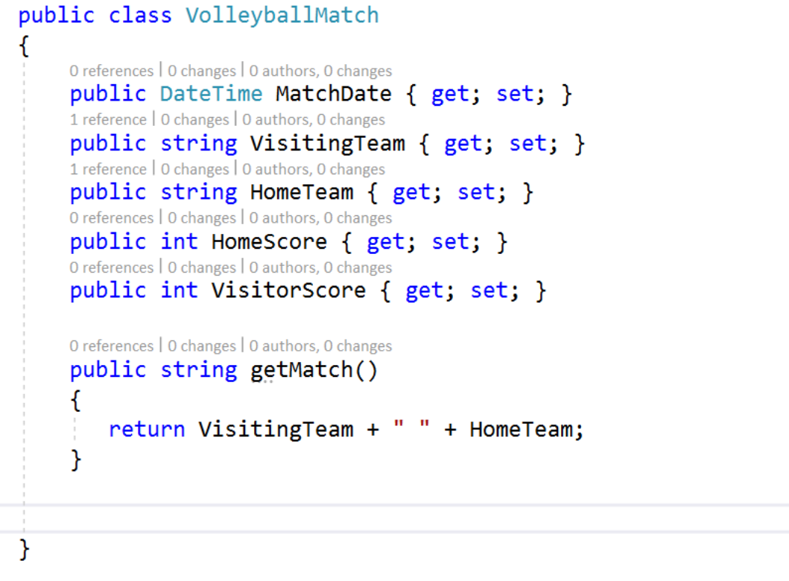
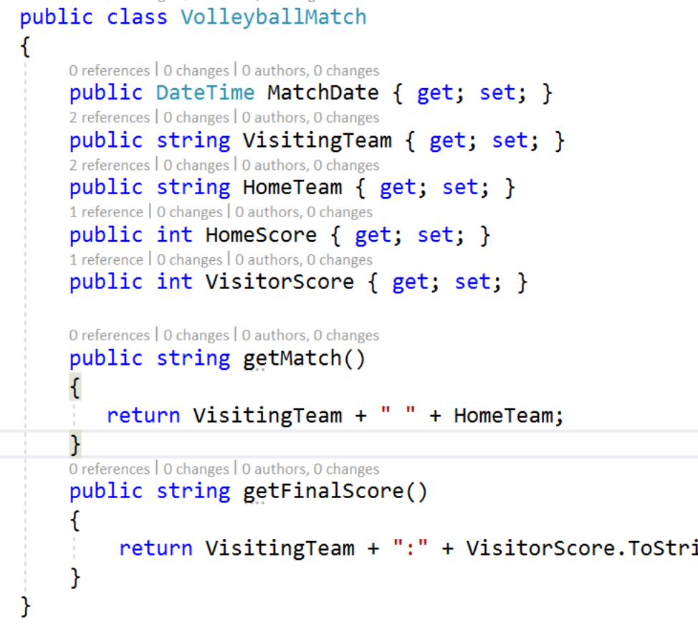
Notes:
One of the challenges, as mentioned before, is getting your database code. Various platforms will allow you to generate the SQL code with different techniques. Since I primarily deal with the Microsoft SQL Server platform, I'll use that in my examples, but the ideas are applicable to any platform.
There are two issues with tracking code. The first is what code am I capturing, and the second is the mechanical process. We will discuss some techniques for the mechanics in a moment, but let's first talk about what code we capture.
In application code, I always see the full set of code for a structure. For example, in a simple C# class, I might have a class like this. If I decide to a method, I have a complete set of code that existed, and my changes. At any point in time, I really have valid code.

Slide 6
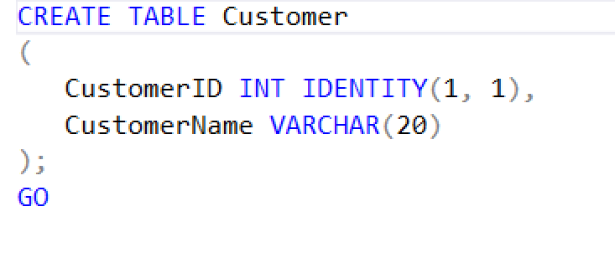
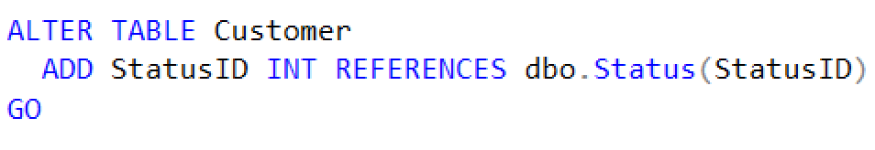
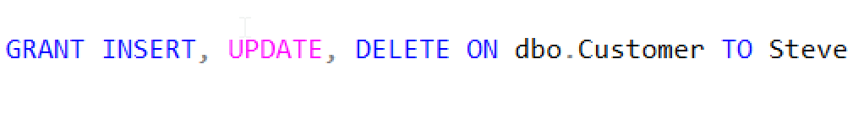

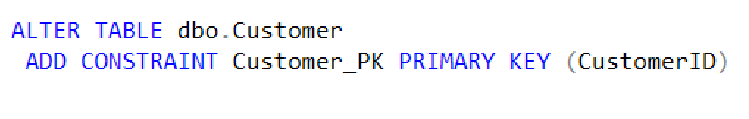
Notes:
Contrast this with SQL code. If I create a table, I use this code. If now want to add a FK, I use this code, which is part of the table, but isn't valid if the table doesn't exist. If I now want to add permissions, that's separate code. If I realize I've made a mistake in design, I use different code still. If I also then decide to add a PK, still more code. These need to be run in this order, and potentially may need still further code if data exists in the table. If I were to store these five items in my VCS, because they're the "versions" of the table, I need to really see all versions to understand my table. Or I need to always store the current "CREATE" script.
No matter what process you use, you will want to capture revisions to the objects, which means you need a VCS of some sort. While there are many you can use, I tend to prefer git, and I usually use the git services provided by VSTS. That is what we will use in examples and demos for this section.

Slide 7
Manually Tracking Database Code
File | Open, File | Save (manual tracking)
Cumbersome
Easy to forget
Need a file structure
All objects in one folder (SSMS default)
Schema name folder and object type folder
Object type folders, schema in file name.
Number the script files for execution order
Notes:
If you are writing the code yourself, as in typing T-SQL into some editor, you can perform a File | Save operation to capture your code. Whether you work in Visual Studio or Management Studio, each time you create a new object, you can save your code to the file system. Each time you need to edit an object, you may need to open the file corresponding to the object code.
However, this does mean that you need to organize your code somehow and properly name the objects. One way to do this is shown on the slide. This is what SSMS will generate for you when you script out each object in your database to a separate file. This becomes confusing quickly, especially in a manual process as the naming of the object includes the type. When trying to find a particular type of object to edit, this can be cumbersome for the developer.

Slide 8
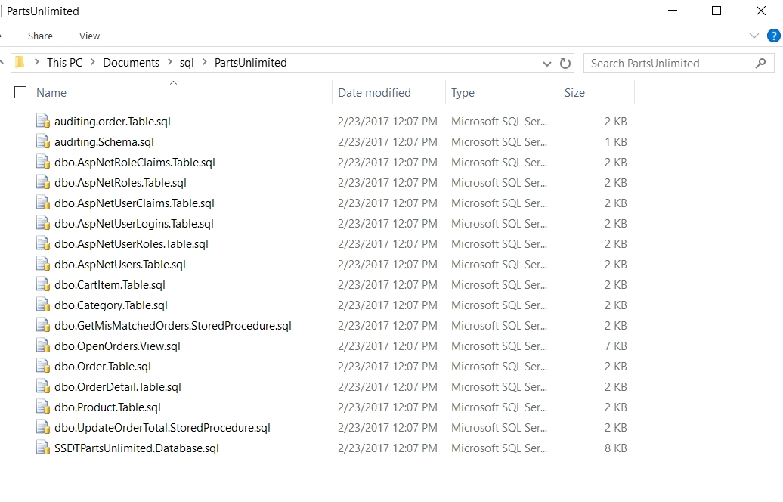

Slide 9
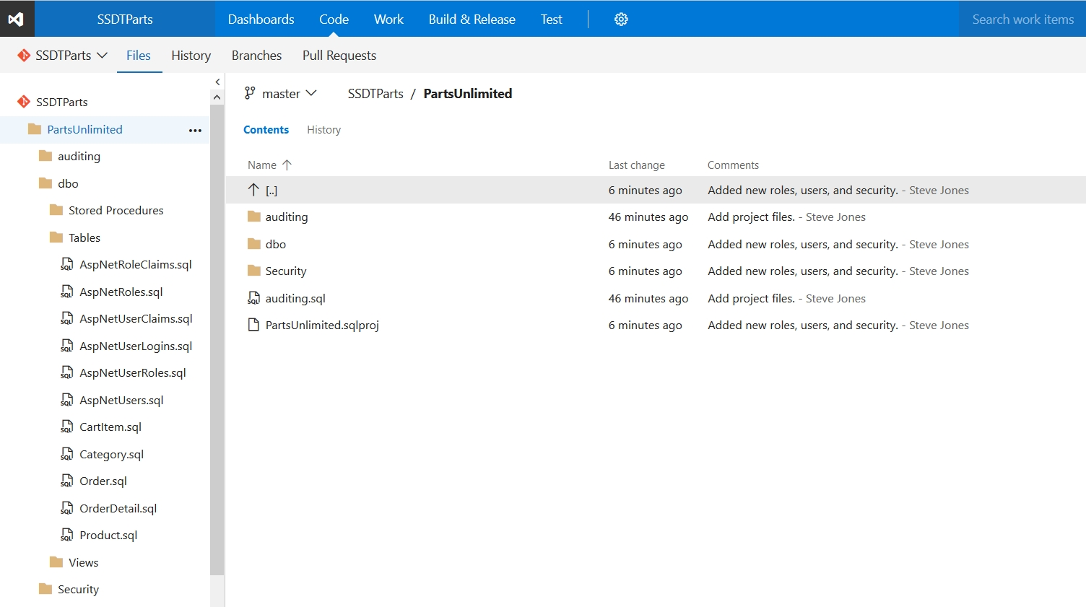
Notes:
Another way is to use the default SSDT structure, which is shown here in my VSTS repository. In this structure the code is stored under a folder named for the schema (dbo and auditing) with subfolders for each type of object and then a single .SQL file that is named for the object. Other items, such as users and roles, are stored under the "Security" folder at the top level.

Slide 10
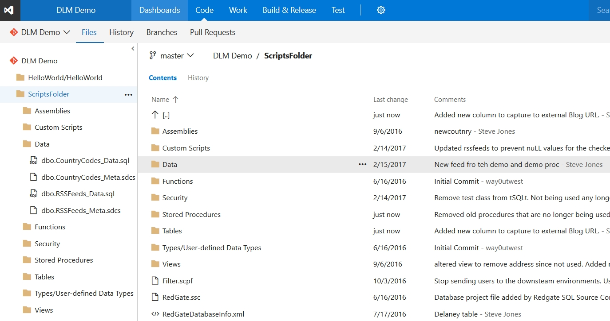
Notes:
Yet another way to manage your code is include all the objects at the top level, as shown here. This is how SQL Source Control from Redgate will setup a repository. In addition to the various SQL Server objects, there are Data and Custom Scripts folders to keep additional code.

Slide 11
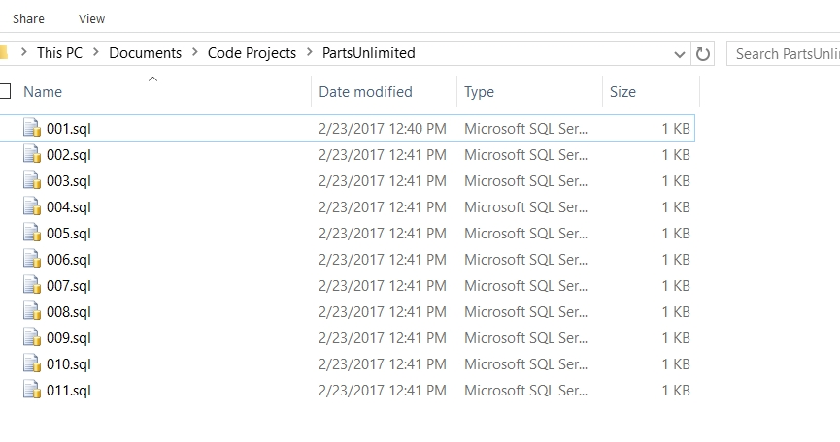
Notes:
A final way of managing your code is what many migration tools and frameworks use, which is to number your script files. Each of these files could contain code that create any type of objects, changes data, alters security, or even performs multiple changes. The naming in this case is chosen to simply the deployment process where some program will execute each script file in order.
No matter which of these you choose, all your developers will need to adopt the habit of saving their code as files in addition to compiling the code in their SQL Server database.

Slide 12
Demos
Use SSDT
Use ReadyRoll
Use SOC

Slide 13
2.3 – What is CI?

Slide 14
What is Database Continuous Integration
Continuous Integration (CI) typically involves
Trigger based on a commit to source control
Automatically compiling all code (build)
Executing automated tests
Publish a release candidate of the compiled code.
Notes:
CI for most code involves taking all of the changes made by a developer and adding them to the existing code base, performing a compile, running automated tests, and ensuring the there are no errors. If this is the case, then the resulting build artifact (.exe, .dll, .jar, etc) is output as an artifact and stored.
The idea here is that small changes can be assessed as to whether they cause issues with other developer changes.
## Continuous Integration for Database Code
For databases, many developers work in a shared database so that changes made can be seen by all other developers. In this way, theoretically, any issues are detected early.
The reality is that often this doesn't detect changes and since all developers see all objects, we can easily overwrite another developer's changes. In addition, if we are not running a complete set of code against the database, meaning testing all application code that interacts with the database, we can easily miss potential issues.
A database CI process should function similarly to an application process, but there are a couple differences. We will still perform a build of the software, test it, and output an artifact, but the process is slightly different.
First, the compile process requires that we ensure our entire set of code actually compiles. We can do that in two ways, depending on our development model. Let's look at each of these.

Slide 15
What is Database Continuous Integration
For state based database development
Trigger based on code commit to source control
Recompile all code on a database (build)
Run automated tests
Publish a package containing the current versions of all code
For migration based development
Run a project build to validate all scripts
Run automated tests
Publish a package containing the upgrade scripts needed for the target database (or all migration scripts).
Notes:
### State based development.
To perform the build, we can create a scratch database and execute all code against it to verify there are no issues, ensuring that all of our code is sytactically correct and all necessary object references are correct.
This type of build essentially uses comparison technology to move all code from our VCS to a blank database, creating all objects. If there are migration, data, or other scripts that need to be included, they need to be a part of this process. This doesn't ensure that our upgrade script will work, but just provides a "fail fast" test of all our code.
### Migration based development
In the case of migration scripts for all our changes, all the scripts need to be run, from the first to the last. Again, this mimics the actual actions taken during development, and ensures that our scripts will correctly build a database.

Slide 16
Testing Code
Static Code Analysis and Standards Testing
Unit testing
Functional Testing
Performance Testing
Security Testing
Notes:
## Testing our code
As with application code, we want to run unit tests, and potentially other types of tests, against our database code. The idea with automating these tests is that we ensure the tests are always run against code that is checked into our system. This avoids the forgetful developer that might not run all the tests, or does not have all the tests on their system.
The idea with using tests in a CI process is that we try to fail the build fast and let developers know there is an issue. How we choose to do this is up to us, but there are a few types of unit tests for your database that you might stage and run in serial or parallel to give a developer quick feedback on their commit.
There are various types of testing, but we will limit CI testing to
* Static Code Analysis and Standards Testing
* Unit testing
* Functional Testing
* Performance Testing
* Security Testing
We will talk more about testing in the next module, but for now, understand that each of these should be performed at some point in our software development pipline. In general, we want to fail the build quickly if there are issues and let the developer know.
Since testing usually needs a database, and some of these types of tests require test data, these are usually performed as a separate build that isn't executed after every commit, but rather at discrete times when we are find application code is ready to release, or the changes may impact the live application. In those cases, we would start another build process that performs the functional, performance or load testing, and security testing of our database.

Slide 17
2.4 – Continuous Testing

Slide 18
Testing in Database Continuous Integration
Standards and Static Code Analysis
Unit Tests
Functional Testing
Performance Testing
Security Testing
Notes:
In the last module we briefly touched on testing, but let's look at this in a little more detail. Testing database code is a bit different than other application code, with some requirements, so let's first talk in more detail about the types of testing we want to perform.
There are a number of types of tests we perform in software development, such as
* Static Code Analysis and Standards Testing
* Unit testing
* Functional Testing
* Performance Testing
* Security Testing
There may be other types, but typically we want to ensure all our database code is well tested, simple mistakes are caught, and regression bugs are avoided.

Slide 19
Standards and Static Code Analysis Tests
These are tests to ensure that code is consistent.
Can include naming, DRI, index requirements, poor programming patterns and more.
Testing Tools
SQL Cop - http://sqlcop.lessthandot.com/
SQL Code Guard - https://sqlcodeguard.com/
SQL Enlight - http://www.ubitsoft.com/products/sqlenlight/
Notes:
## Standards tests and Static Code Analysis Tests
One thing that can help ensure your code is easier for your developers to work on is ensuring that the code adheres to certain standards. These might be the requirement that certain names are used, certain structures aren't allowed (such as cursors), or perhaps indexes are required.
The idea with these tests is that the code isn't executed, but examined for structural issues. Some of these tests might require the actual database to be built to check the code, but since we do that in the build stage of our CI process, this isn't an issue.
I like to run these tests first, as a first test step that should complete very quickly. If a developer has failed to run these tests on their code, we catch these simple issues quickly, informing the developer of a silly mistake. Over time, as developers learn to code according to the standards and design patterns our organization prefers, these test will likely always pass.
There aren't many static analysis tools available, though I hope that this will change. SQL Englight and SQL Code Guard are the two I know of commercially, and SQLCop is an open source project.
One note I'll make for these types of tests. You need to have the ability to create exceptions for some of these tests. For example, every table should have a primary key, and that's a good test to implement as a static code analysis tests. However, there are reasons to build a table that doesn't have a primary key, for example, for auditing or ETL work. If there is a valid reason to not enforce a PK, then we should have the ability to add an exeption to a test. I've written an article with more technical details on the subject: [Adding PK Exceptions to SQLCop Tests](http://www.sqlservercentral.com/articles/tSQLt/127634/)

Slide 20
Unit Tests
Unit tests are designed to test individual sections of code.
Test stored procedures, functions, and assemblies in isolation.
Data is always consistent in a unit test
Tools
Microsoft Unit Testing
tSQLt
Notes:
## Unit Tests
The idea with unit tests is that we are actually testing that our code works correctly. This is important in our application code, and it can be important in our database code as well.
Since some of our database code is for static objects, such as tables and views, and some is programmatic (functions, stored procedures), we might structure our tests a little differently than we would with application code.
For our tables and views, we often test one of two things. One is that certain referential integrity options exist, and the second is that the API these objects present to our application, which is essentially what their structure creates.
Referential integrity items are those characteristics of our objects. For tables this might be that defaults exist for columns, or that our child table data must have parent rows, or even that computed columns work as expected. For views, we may check on column transformations or even that insert/updates of views work correctly.
Note that we might define referential integrity explicitly, or we may assume that our other code enforces it. In either case, we want to have tests that ensure that anything we need to ensure that must occur in our data structures actually works.
For our functions and stored procedures, we write tests as we would for an application method or function. We can assemble an environment of tables, variables, and data, then run our stored procedure or function, and finally asserting some fact. Each test should pass or fail based on the requirements of that test.
One final note on testing. We typically need test data in order to run our tests. This makes sense as we're testing the database here. We can assemble test data in each unit test, which is what some people prefer, or you can ensure you have a known set of test data that is always added to your CI process. We will discuss test data more in another module, but for now be aware that we want some test data. However, at the end of every test, we should undo any of our work, which usually means creating a transaction at the start of a test and then rolling back that transaction at the end.

Slide 21
Other Tests
Functional Tests
Tests multiple sets of code as one unit, i.e. a stored procedure that calls a function and updates a table.
May include application code test that affect the database
Performance (Load) Tests
Need production sized (or larger) data sets
Should simulate a production (or larger) workload
Maybe run less frequently
Security Tests
Ensure access is limited
More complex to write when roles are not used for assigning rights
Notes:
## Other Tests
We certainly should have other types of tests defined beyond these two types. Our application should be tested with the database at some point, we should have larger, functional tests that might examine multiple parts of database code working together, perhaps testing a stored procedure that calls other stored procedures or functions and verifying the entire process works. We want performance or load tests run with production sized, or ever larger, sets of data. There should be security tests to ensure that we are not granting more access to data than necessary. This last set of tests are probably the most important in today's world, but also the least likely to be run in most development teams. I hope that changes in the future.
We should automate as many of these tests as we can. They can be executed after successful completion of earlier sets or tests or left in separate build pipelines that must be manually executed. We may choose to run some of these tests less frequently than we run unit tests, but we do want to run these regularly to determine the health of our codebase.
We will discuss additional testing a bit more in a later section.
One final note on testing is that 100% test coverage is unlikely for most development teams. However, at the very least you should be creating tests for each issue or bug raised with your team. This will ensure you are writing tests for the common mistakes your team makes.

